Slide 1

Entrepreneurship and Small Business Management
Dr. Eranga Jayasekara

Slide 2
Recognizing Opportunities and Generating Ideas Session 02
Notes:
Change to 9th Edition and change title to Exploring Strategy. Update design. https://www.youtube.com/watch?v=st_5cvHPWrc

Slide 3
Lesson Objectives
Explain why it’s important to start a new firm when its “window of opportunity” is open.
Explain the difference between an opportunity and an idea.
Describe the three general approaches entrepreneurs use to identify opportunities.
Identify the four environmental trends that are most instrumental in creating business opportunities.
List the personal characteristics that make some people better at recognizing business opportunities than others.

Slide 4
Lesson Objectives
Identify the five steps in the creative process.
Describe the purpose of brainstorming and its use as an idea generator.
Describe how to use library and Internet research to generate new business ideas.
Explain the purpose of maintaining an idea bank.
Describe three steps for protecting ideas from being lost or stolen.

Slide 5
What is an Opportunity?
An opportunity is a favorable
set of circumstances that
creates a need for a new
product, service or business.
Opportunity Defined

Slide 6
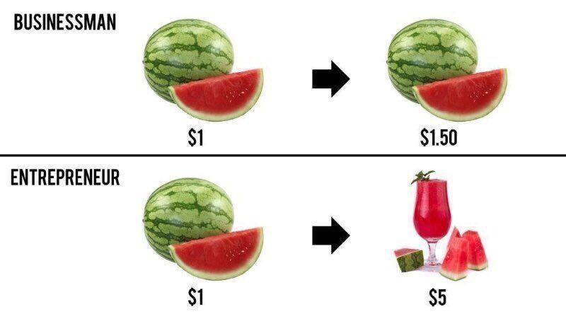

Slide 7
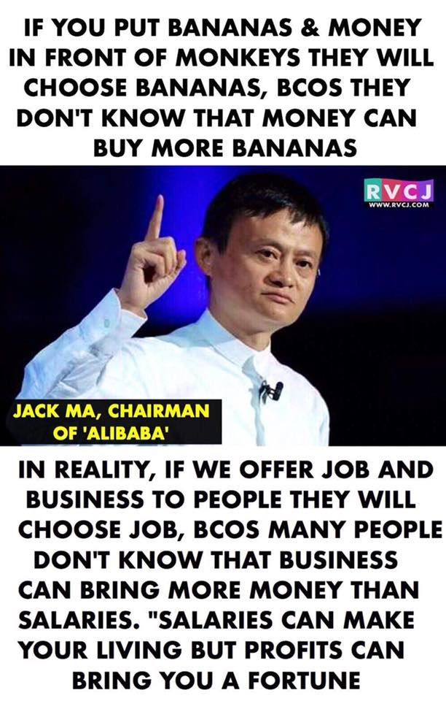

Slide 8

What is an Opportunity?
Entrepreneurial opportunities are those situations in which new goods, services, raw materials, and organizing methods can be introduced and sold at greater than their cost of production (Casson 1982)

Slide 9
Types of Opportunities
New Product
New Market
New Materials
New Method of Production
New Process
New Organization

Slide 10

The window of Opportunity
For an entrepreneur to capitalize on an opportunity, its WINDOW OF OPPORTUNITY must be open.
It is the time period in which firm can realistically enter a new market make a reasonable profit.
Entrepreneurs recognize opportunities and turn them in to successful businesses.

Slide 11
Opportunities
Opportunities for profit
Entrepreneurial Opportunities
Requires Involves optimization within existing ends-means framework
Requires discovery of new ends-means relationships
Kirzner, 1997

Slide 12

Opportunities Discovered or Created?
Researchers in the Schumpeterian stream (Opportunity Creation Stream) focus on the way entrepreneurs enact opportunities in response to, political -legal, economic, social -cultural & technological (PEST) changes in external environment

Slide 13





Schumpeter believed that those exogenous shocks (PEST changes) disrupt the market efficiency creating a disequilibrium and entrepreneurs make use of their early access to such information to create new products, services or processes.

Slide 14

An Opportunity Vs an Idea
An idea is a thought, impression or notion.
It may not meet the criteria of an opportunity
Many businesses fail, not because the entrepreneurs that started them didn’t work hard, but rather because there was no real opportunity
Before getting excited about a business idea, it is crucial to understand whether the idea fills a need and meets the criteria for an opportunity.

Slide 15
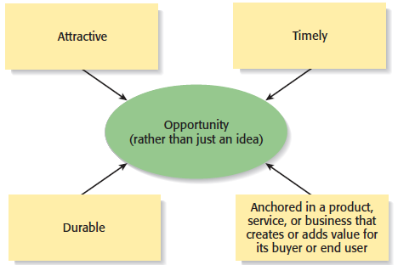
What is an Opportunity?
An opportunity has four essential qualities

Slide 16

Three Ways to Identify an Opportunity
Political
Economical
Social
Technological
Environmental
Ecological
Legal

Slide 17
First Approach: Observing Trends
Observing Trends
Trends create opportunities for entrepreneurs to pursue.
The most important trends are:
Economic forces.
Social forces.
Technological advances.
Political action and regulatory change.
It’s important to be aware of changes in these areas.

Slide 18
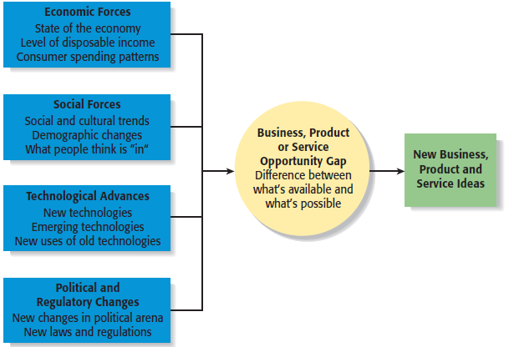
First Approach: Observing Trends
Environmental Trends Suggesting Business or Product Opportunity Gaps

Slide 19
Trend 1: Economic Forces
Example of Economic Trend Creating a Favorable Opportunity
Economic trends help determine areas that are ripe for new startups and areas that startups should avoid.
A weak economy favors
startups that help consumers
save money.
An example is GasBuddy.com,
a company started to help
consumers save money on gas.

Slide 20
Trend 2: Social Forces
Examples of Social Trends
Social trends alter how people and businesses behave and set their priorities. These trends provide opportunities for new businesses to accommodate the changes.
Retirement of baby boomers.
The increasing diversity of
the workplace.
Increasing interest in health,
fitness, and wellness.
Emphasis on alternative forms
of energy.
New forms of music and other
types of entertainment.

Slide 21
Trend 3: Technological Advances
Examples of Entire Industries that Have Been Created as the Results of Technological Advances
Advances in technology frequently create business opportunities.
Computer industry
Internet
Biotechnology
Digital photography

Slide 22
Trend 3: Technological Advances
Example: H2OAudio
Once a technology is created, products often emerge to advance it.
An example is H2OAudio, a company started by four former San Diego State University students, that makes waterproof housings for the Apple iPod and accessories for portable media players. During 2008 it was notable for being one of the top 500 fastest growing companies in the United States..

Slide 23
Trend 4: Political Action and Regulatory Changes
General Example
Political action and regulatory changes also provide the basis for opportunities.
Laws to protect the environment have created opportunities for entrepreneurs to start firms that help other firms comply with environmental laws and regulations.

Slide 24
Trend 4: Political Action and Regulatory Changes
Specific Example
Company created to help other companies comply with a specific law.
The No Child Left Behind Act of 2002 requires states to develop criterion-based assessments in basic skills to be periodically given to students in certain grades. Kim and Jay Kleeman, two high school teachers, started Shakespeare Squared, a company that helps high schools comply with the act.

Slide 25
Eg:- Sri Lanka Overview -2015: The World Bank
By 2036, more than 22 percent of the population will be over 60, and there will be 61 dependents per 100 adults
Employment in primary agriculture will likely continue to decline from its present share of 30 percent of the labor force as other sectors of higher productivity absorb rural surplus labor.
At the same, along with productivity increases, agriculture is likely to become more capital intensive and technology-driven as labor shortages emerge.
Against the background of an aging society, efficient and well- targeted social assistance will also become more important

Slide 26
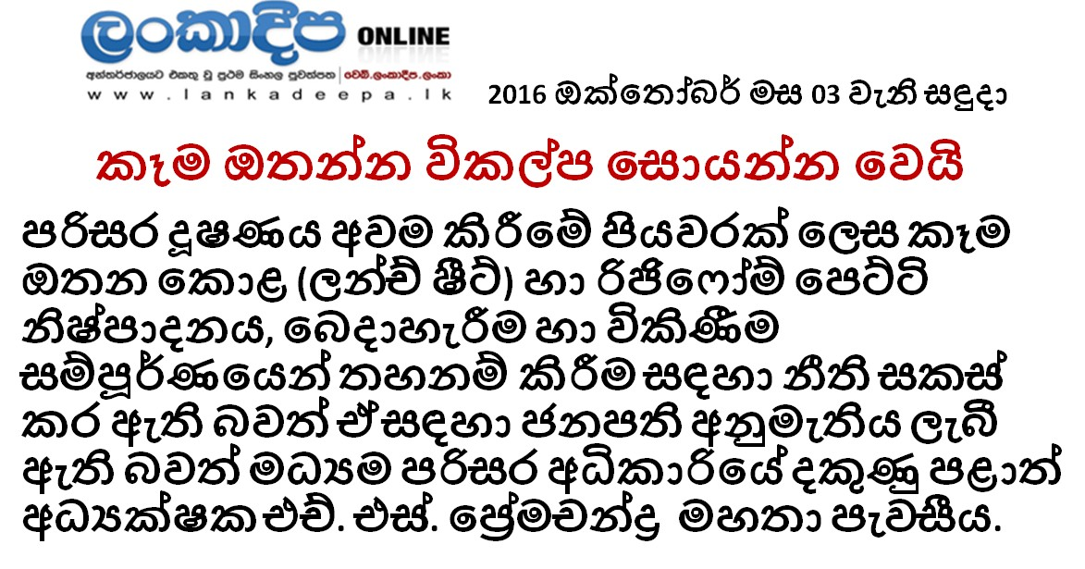

Slide 27
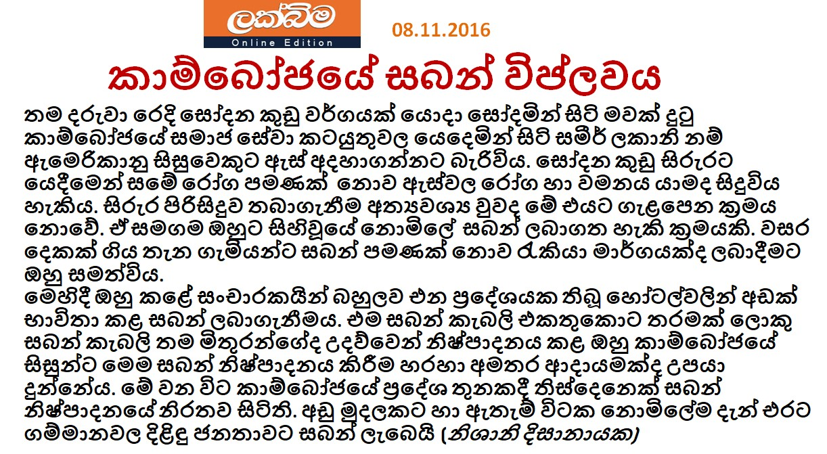

Slide 28
Second Approach: Solving a Problem
Solving a Problem
Sometimes identifying opportunities simply involves noticing a problem and finding a way to solve it.
These problems can be pinpointed through observing trends and through more simple means, such as intuition or change.
“Every problem is a brilliantly disguised opportunity”
Eg:
Symantec Corporation – Norton Antivirus – Security of Computers
Body Shop – Non availability of samples for body lotions
Yahoo -No method to find and organize favorite web sites

Slide 29
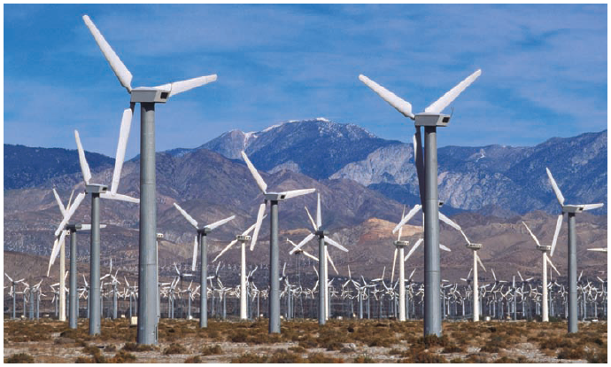
Second Approach: Solving a Problem
A problem facing the U.S. and
other countries is finding
alternatives to fossil fuels.
A large number of
entrepreneurial firms, like
this wind farm, are being
launched to solve this problem.

Slide 30
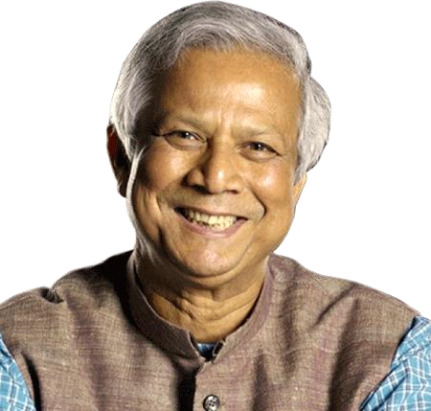
Garmin Bank: The Bank of the Villages
“Whenever I see a problem I immediately go and create a company. That is what I did all of my life”
© Shyaman Udayanga 0715328966

Slide 31
Third Approach: Finding Gaps in the Marketplace
Gaps in the Marketplace
A third approach to identifying opportunities is to find a gap in the marketplace
A gap in the marketplace is often created when a product or service is needed by a specific group of people but doesn’t represent a large enough market to be of interest to mainstream retailers or manufacturers.

Slide 32
Third Approach: Finding Gaps in the Marketplace
Specific Example
Product gaps in the marketplace represent potentially viable business opportunities.
In 2000 Tish Ciravolo realized there were no guitars on the market made specifically for women. To fill this gap, she started Daisy Rock Guitars (Now $ 2.4 million worth company serves in 25 countries), a company that makes guitars just for women.

Slide 33
Personal Characteristics of the Entrepreneur
Characteristics that tend to make some people better at recognizing opportunities than others
Prior Experience
Cognitive Factors
Social Networks
Creativity
Notes:
Cognitive factors are those characteristics of a person that affect the way they learn and perform. Examples of these cognitive functions are things like memory, attention, and reasoning

Slide 34
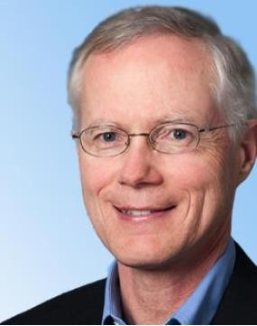




An opportunity with no or very low potential can be an enormously big opportunity.
Eg: 01
Scott Cook / Tom Proulx Co-founders
Intuit, maker of Quicken software was rejected by 20 venture capitalists before securing backing.

Slide 35




Eg 02:
Apple Computer Inc. founders Steve Jobs and Steve Wosniac approached their employer HP Corporation , with the idea for a desktop personal computer and were told this was not an opportunity for HP. Hence, Jobs and Wosniac started their own company.

Slide 36
Individual Differences and Opportunity Identification
The willingness of entrepreneurs to exploit opportunities is a function of various individual differences (Shane and Venkataraman 2000)
Psychological and demographic characteristics represent examples of these individual differences and have been found to impact the likelihood that an individual will engage in entrepreneurial activity (Kristiansen and Indarti 2004)

Slide 37
Determinants of Opportunity Identification
Entrepreneurial Alertness
Informational Asymmetry
Opportunity Identification
Social Networks
Identification of
Means-end relationships
Source: Certo & Certo, 2015

Slide 38
Entrepreneurial Alertness
An individual’s ability to notice and be sensitive to new information about objects, incidents, and patterns of behaviour in the environment
Higher the alertness higher the opportunity identification

Slide 39
Informational Asymmetry
Individuals vary in terms of the information to which they have access
Individuals who have access to updated, useful information may exploit opportunity better than others

Slide 40
Social Networks
Individual who have extended social networks may exploit opportunity better than those who have narrow social networks

Slide 41
Identification of Means-end relationships
Means-end relationships refers to the ability of entrepreneur to understand how to turn a new technology in to a product or service that will be valued by customers
Individuals who have better ability to assess means-ends relationships may exploit opportunity better than others

Slide 42
Opportunity Evaluation
Conduct Feasibility Analysis to whether the idea is practical
Consider, consumer demands, structure of the industry, entrepreneur’s capabilities
Investigate entrepreneurial risk – likelihood and magnitude of opportunity’s Downside Loss
Downside-Loss refers to the resources the entrepreneur could lose if the opportunity does not succeed
Be careful of “Law of small numbers” and “Illusion of Control”

Slide 43
Factors Influencing Opportunity Exploitation
Customer Value of Product or Service
Stakeholder Support
Opportunity Exploitation
Capable Management Team
Source: Certo & Certo, 2015

Slide 44







Opportunity Exploitation: Starting the Venture

Slide 45
Prior Experience
Prior Industry Experience
Several studies have shown that prior experience in an industry helps an entrepreneur recognize business opportunities.
By working in an industry, an individual may spot a market niche that is underserved.
It is also possible that by working in an industry, an individual builds a network of social contacts who provide insights that lead to recognizing new opportunities.

Slide 46
Cognitive Factors
Cognitive Factors
Studies have shown that opportunity recognition may be an innate skill or cognitive process.
Some people believe that entrepreneurs have a “sixth sense” that allows them to see opportunities that others miss.
This “sixth sense” is called entrepreneurial alertness, which is formally defined as the ability to notice things without engaging in deliberate search.

Slide 47
Social Networks
Social Networks
The extent and depth of an individual’s social network affects opportunity recognition.
People who build a substantial network of social and professional contacts will be exposed to more opportunities and ideas than people with sparse networks.
In one survey of 65 start-ups, half the founders reported that they got their business idea through social contacts.
Strong Tie Vs. Weak Tie Relationships
All of us have relationships with other people that are called “ties.”

Slide 48
Social Networks
Nature of Strong-Tie Vs. Weak Tie Relationships
Strong-tie relationship are characterized by frequent interaction and form between coworkers, friends, and spouses.
Weak-tie relationships are characterized by infrequent interaction and form between casual associations.

Slide 49
Creativity
Creativity
Creativity is the process of generating a novel or useful idea.
Opportunity recognition may be, at least in part, a creative process.
For an individual, the creative process can be broken down into five stages.

Slide 50
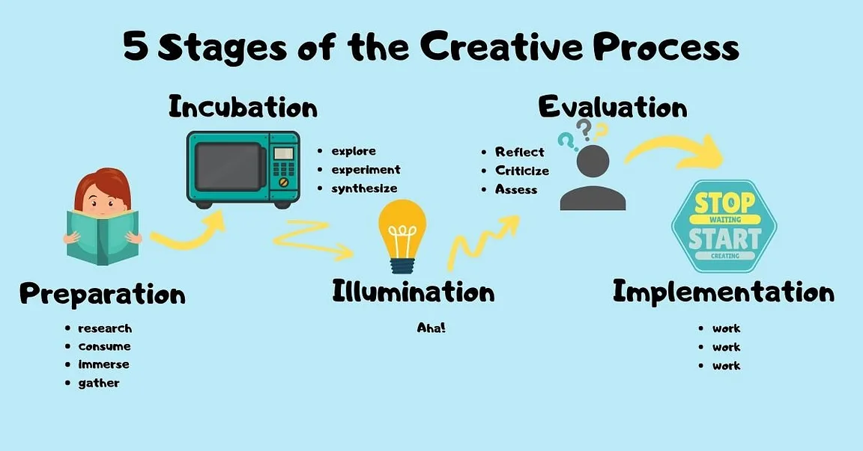
Creativity
Five-Steps to Generating Creative Ideas
https://www.youtube.com/watch?v=ybNoYjLmfPA
Notes:
Preparation: The first stage involves prep work and idea generation. This step involves a creative brief and includes things like researching a brand, the target audience, or gathering inspirations from other sources. If you’re a writer, you’re reading other works in the same area. If you’re a musician, you’re listening to other pieces of music that inspires you. The same applies for the creative class of graphic designers and digital artists.
Incubation: This step is where the “magic” happens for most creatives. After we absorb all the information from the Preparation phase, the next step is to let the ideas marinate in our subconscious. This is when you step away from the problem and do something else; that could be grabbing lunch, going for a run, watching TV, taking a shower, doing laundry, or getting a good night’s rest. During this time, your story or song or problem is incubating in the back of your mind.
Illumination / insight: This is the lightbulb moment - the “Aha!” moment, The “Eureka!” - the moment when the perfect idea hits you like a bolt of lightning. As a mentor of mine once said, the best ideas come when two unrelated ideas bounce around in your brain for a while and collide together to create something amazing. When this moment hits, a person might rush to their sketchbook or keyboard to jot it down before it escapes them.
Evaluation: This is the hard part, where you look at all the ideas before you and narrow it down to which ones work and which ones don’t. This is usually the phase when client feedback comes into the mix and you, your team and the client weigh different options and decide what works for the problem at hand.
Elaboration / Implementation: You’ve done the work, you’ve narrowed it down, you’ve decided on a direction, now go! This is the part where the final product gets produced, where things like skill, experience, knowledge, and hours of work come in to play. This is the writer’s final draft, the artist’s finished piece, the musician’s live performance. The satisfaction of a job well done after this stage makes all the hours of hard work worth it.

Slide 51
Full View of the Opportunity Recognition Process
The connection between an awareness of emerging trends and the personal characteristics of the entrepreneur

Slide 52
Techniques For Generating Ideas
Brainstorming
Focus Groups
Library and
Internet Research

Slide 53
Brainstorming
Brainstorming
Is a technique used to generate a large number of ideas and solutions to problems quickly.
A brainstorming “session” typically involves a group of people, and should be targeted to a specific topic.
Rules for a brainstorming session:
No criticism.
Freewheeling is encouraged.
The session should move quickly.

Slide 54
Focus Groups
Focus Group
A focus group is a gathering of five to ten people, who have been selected based on their common characteristics relative to the issues being discussed.
These groups are led by a trained moderator, who uses the internal dynamics of the group environment to gain insight into why people feel the way they do about a particular issue.
Although focus groups are used for a variety of purposes, they can be used to help generate new business ideas.

Slide 55
Library and Internet Research
Library Research
Libraries are an often underutilized source of information for generating new business ideas.
The best approach is to talk to a reference librarian, who can point out useful resources, such as industry-specific magazines, trade journals, and industry reports.
Simply browsing through several issues of a trade journal or an industry report on a topic can spark new ideas.

Slide 56
Libraries and Internet Research
Examples of Useful Search Engines and Industry Reports
Large public and university libraries typically have access to search engines and industry reports that would cost thousands of dollars to access on your own.
Lexis-Nexis Academic
ProQuest
IBISWorld
Mintel
Standard & Poor’s Net
Advantage

Slide 57
Library and Internet Research
Internet Research
If you are starting from scratch, simply typing “new business ideas” into a search engine will produce links to newspapers and magazine articles about the “hottest” new business ideas.
Subscriptions to e-mail alerts will provide you to links to a constant stream of newspaper articles, blog posts, and news releases about the topic.
Targeted searches are also useful.

Slide 58
Other Techniques
Customer Advisory Boards
Some companies set up customer advisory boards that meet regularly to discuss needs, wants, and problems that may lead to new ideas.
Day-In-The-Life Research
A type of anthropological research, where the employees of a company spend a day with a customer.
Government support
National Enterprise Development Authority, Small Enterprises Development, Entrepreneurship Development – NAITA,

Slide 59
Encouraging New Ideas
Establishing a Focal Point for Ideas
Some firms meet the challenge of encouraging, collecting, and evaluating ideas by designating a specific person to screen and track them—for if its everybody’s job, it may be no one’s responsibility.
Another approach is to establish an idea bank (or vault), which is a physical or digital repository for storing ideas.
Encouraging Creativity at the Firm Level
Creativity is the raw material that goes into innovation and should be encouraged at the organizational and individual supervisory level.

Slide 60
Protecting Ideas From Being Lost or Stolen
Step 1
The idea should be put in a tangible form such as entered into a physical idea logbook or saved on a computer disk, and the date the idea was first thought of should be entered.
Step 2
The idea should be secured. This may seem like an obvious step, but is often overlooked.
Step 3
Avoid making an accidental or voluntary disclosure of an idea, in a manner that penalties the right to claim exclusive rights to it.

Slide 61

All rights reserved. No part of this publication may be reproduced, stored in a retrieval system, or transmitted, in any form or by any means, electronic, mechanical, photocopying, recording, or otherwise, without the prior written permission of the publisher. Printed in the United States of America.
Copyright ©2010 Pearson Education, Inc. publishing as Prentice Hall

Slide 62
The End

